Slide 1


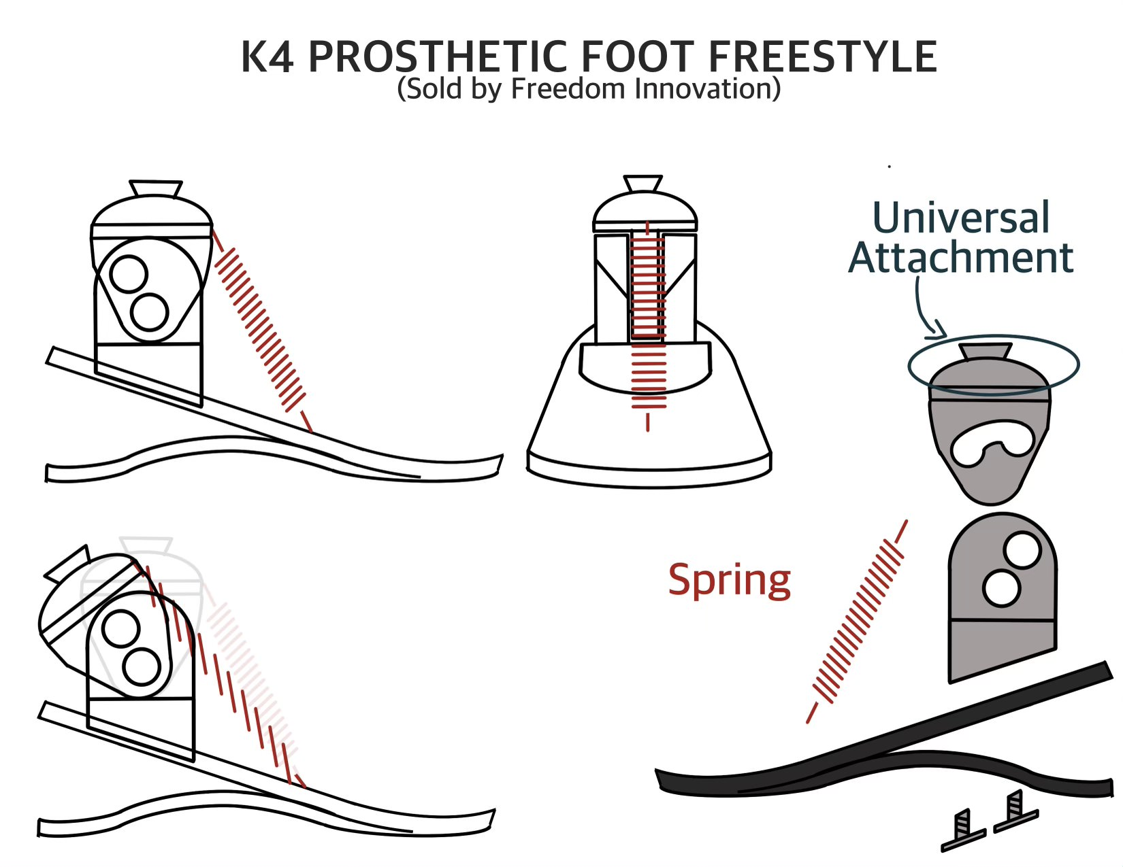
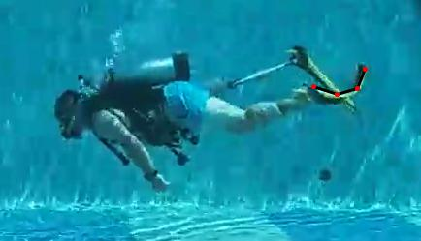
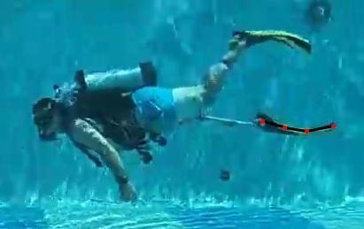
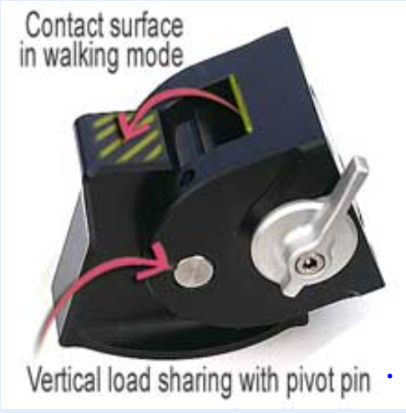
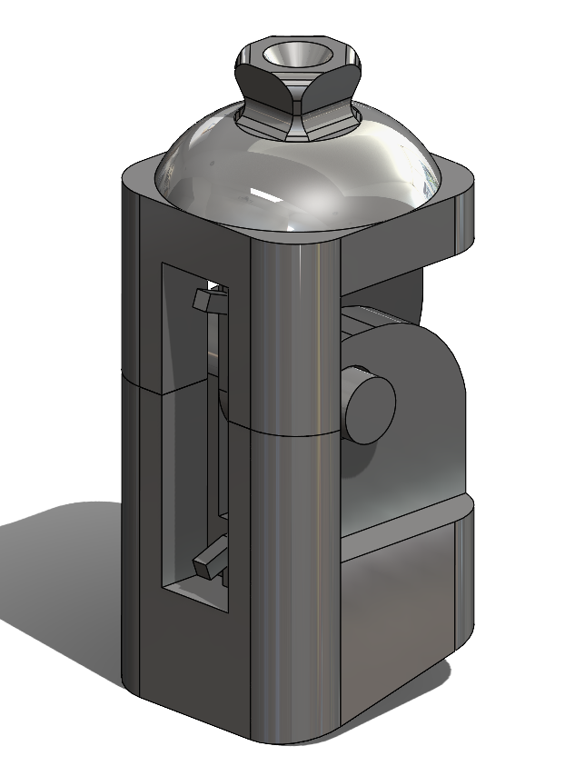
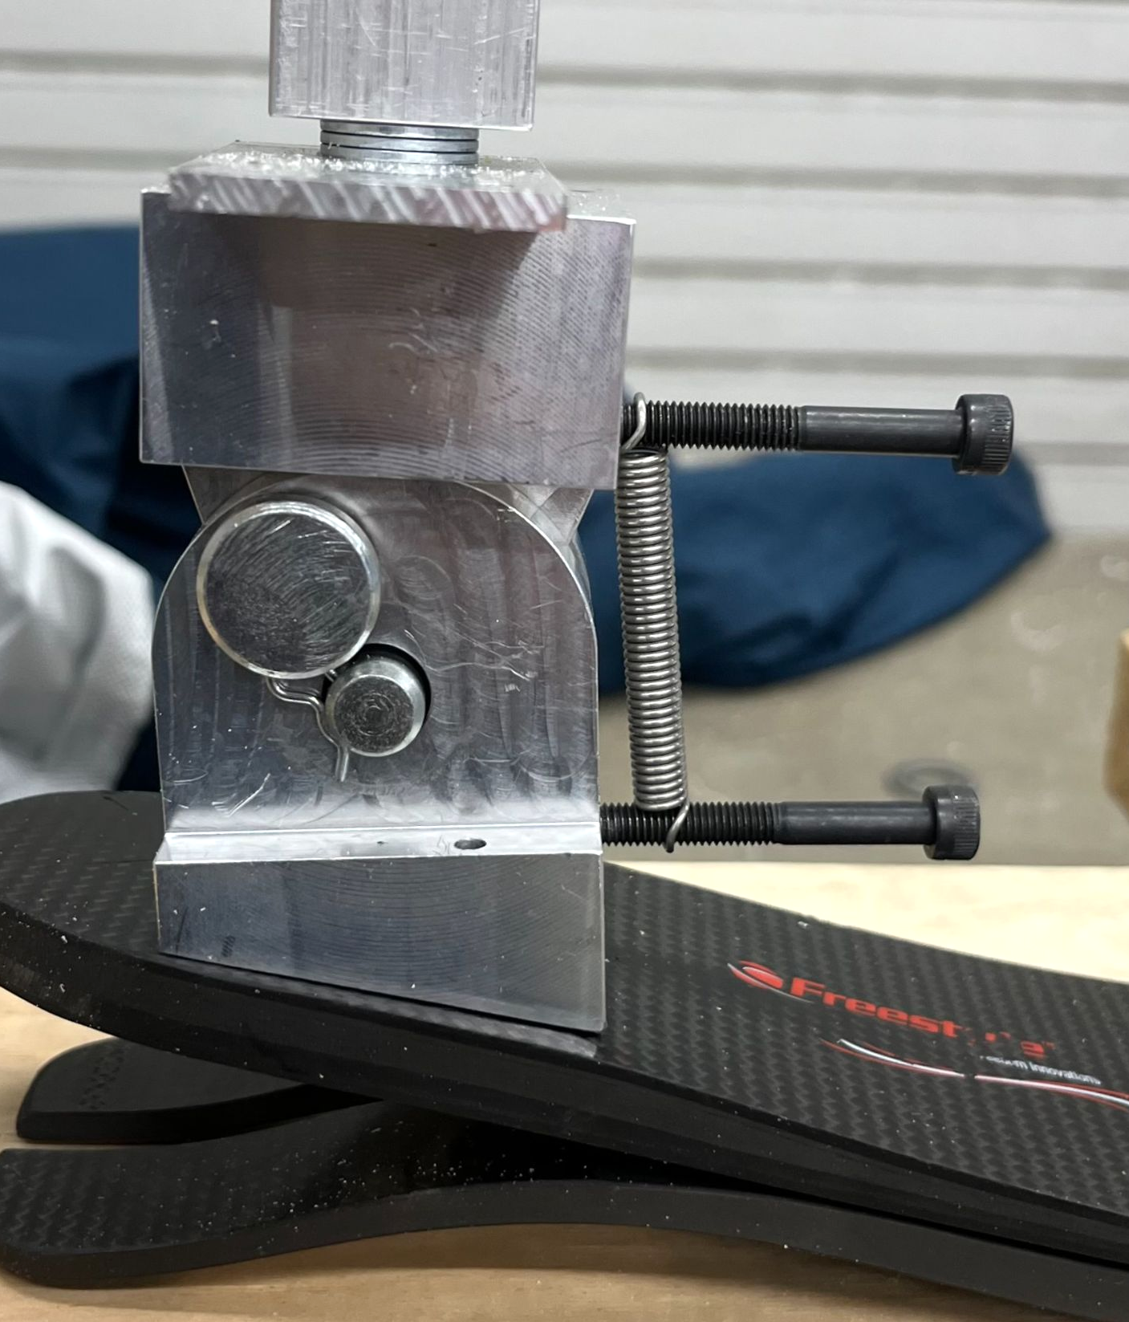
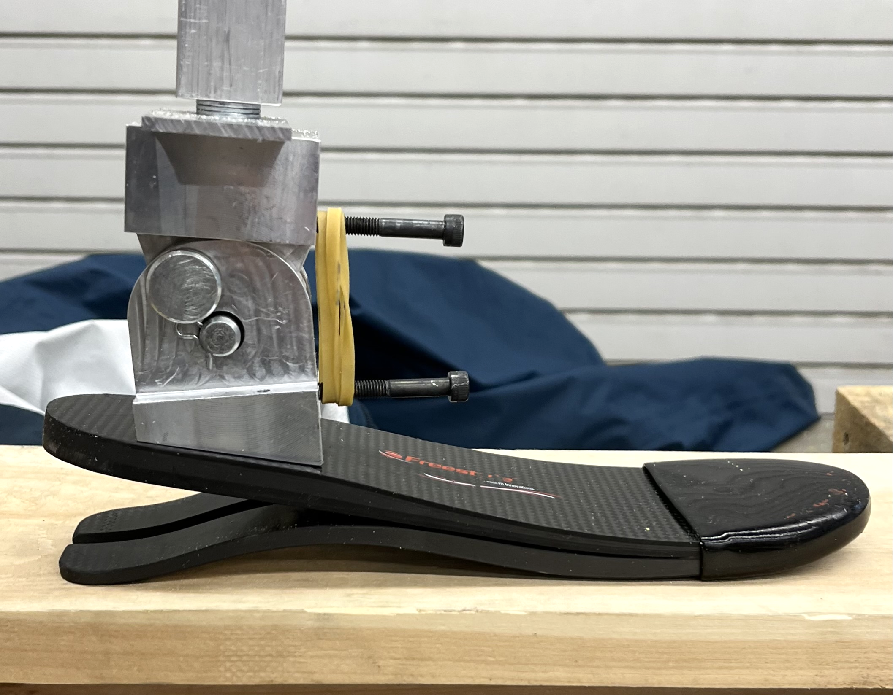
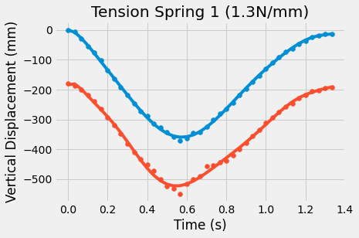
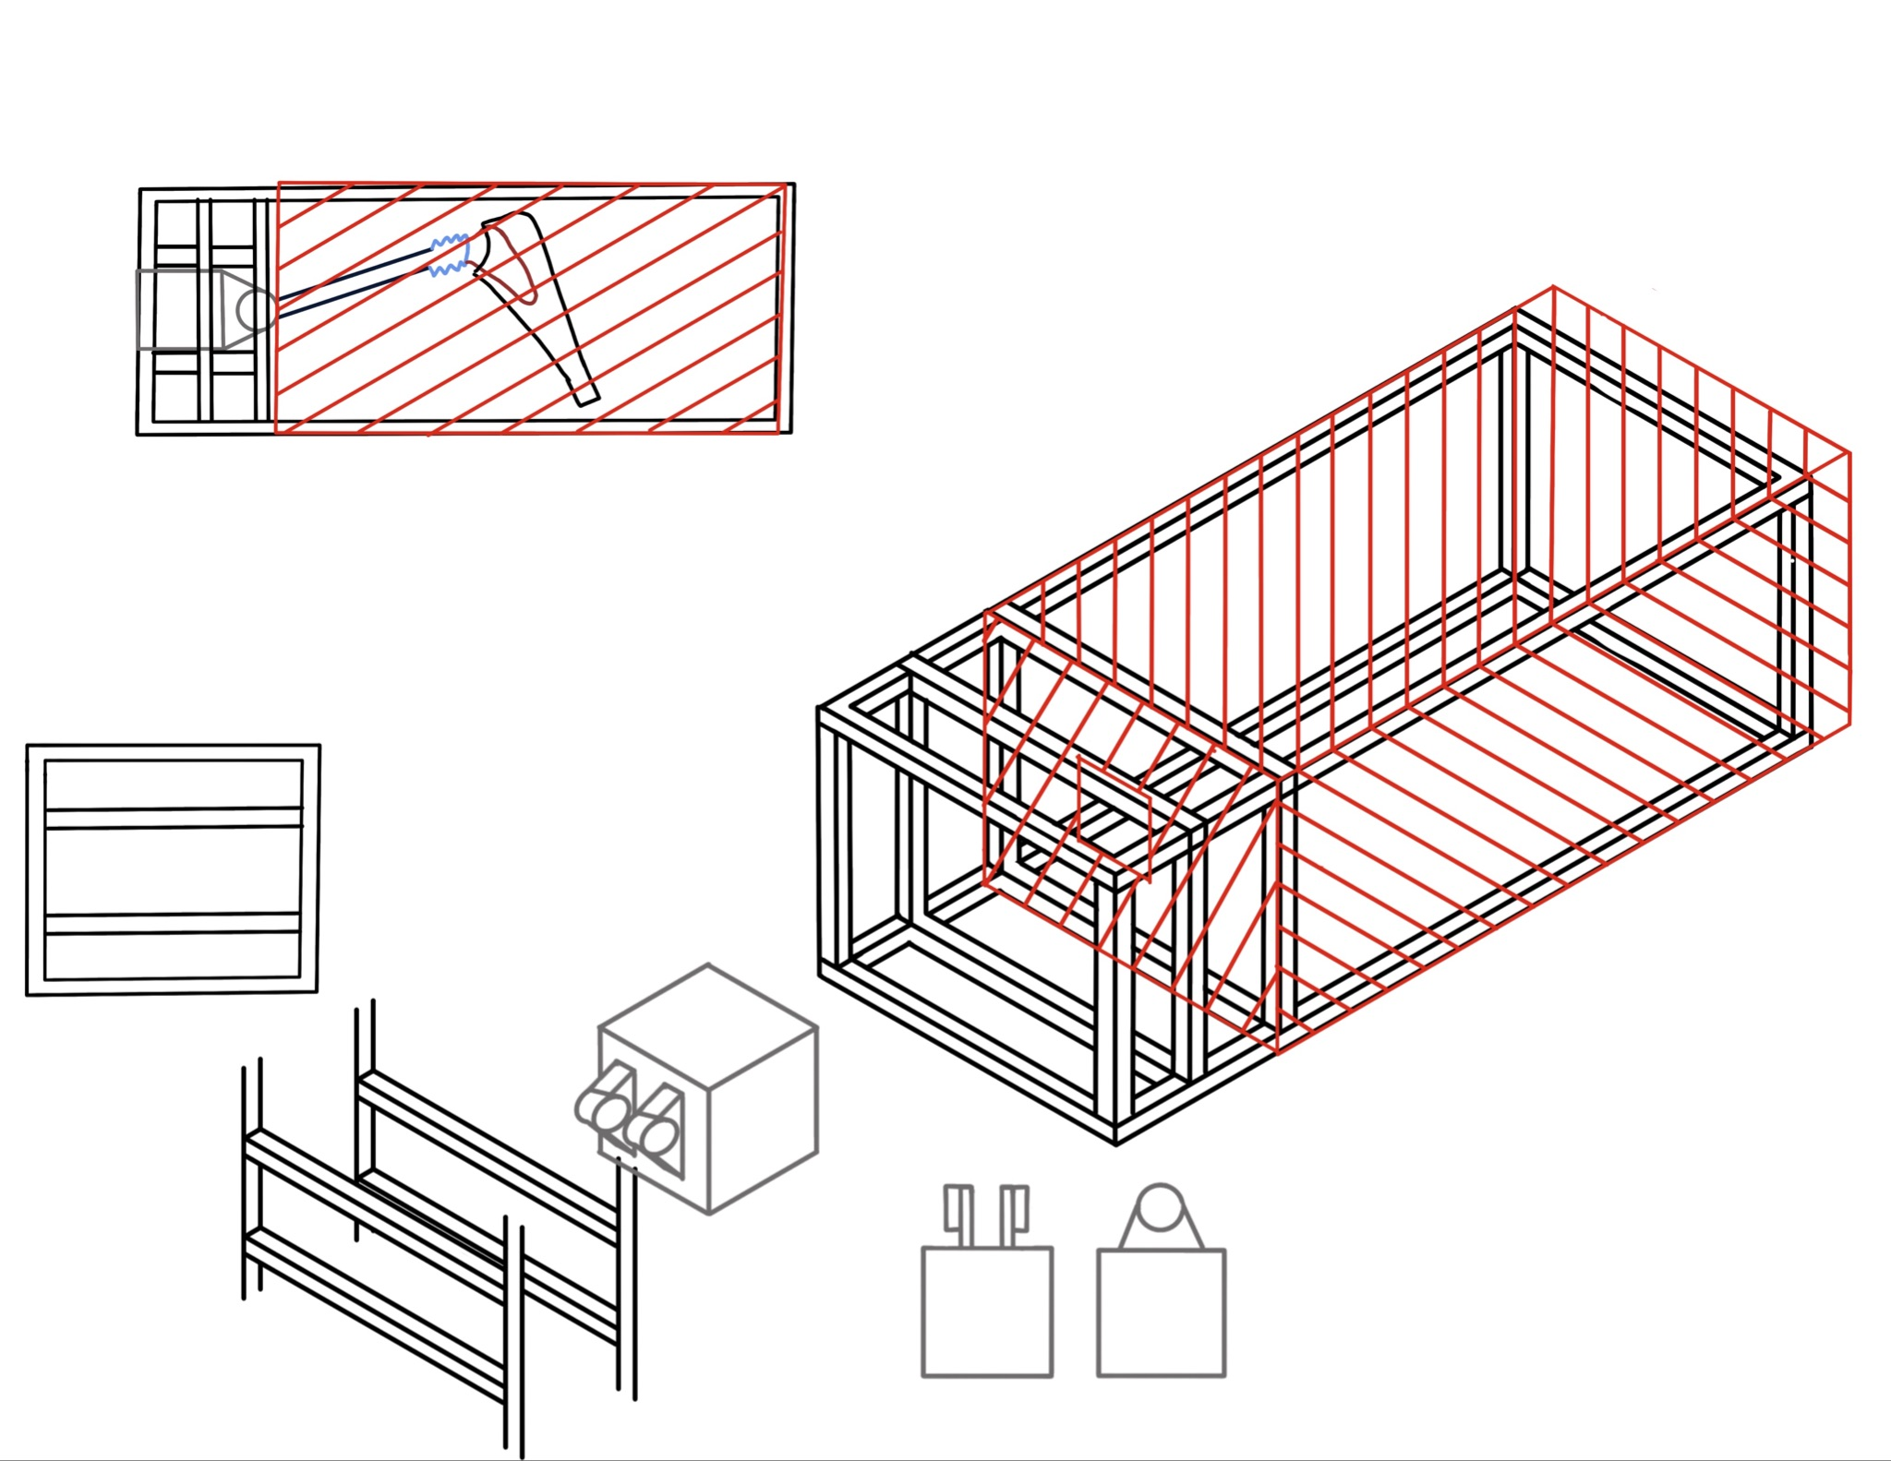
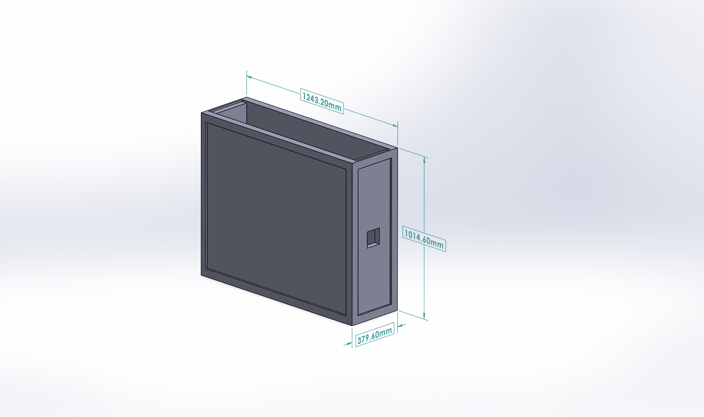
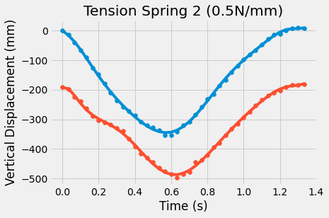
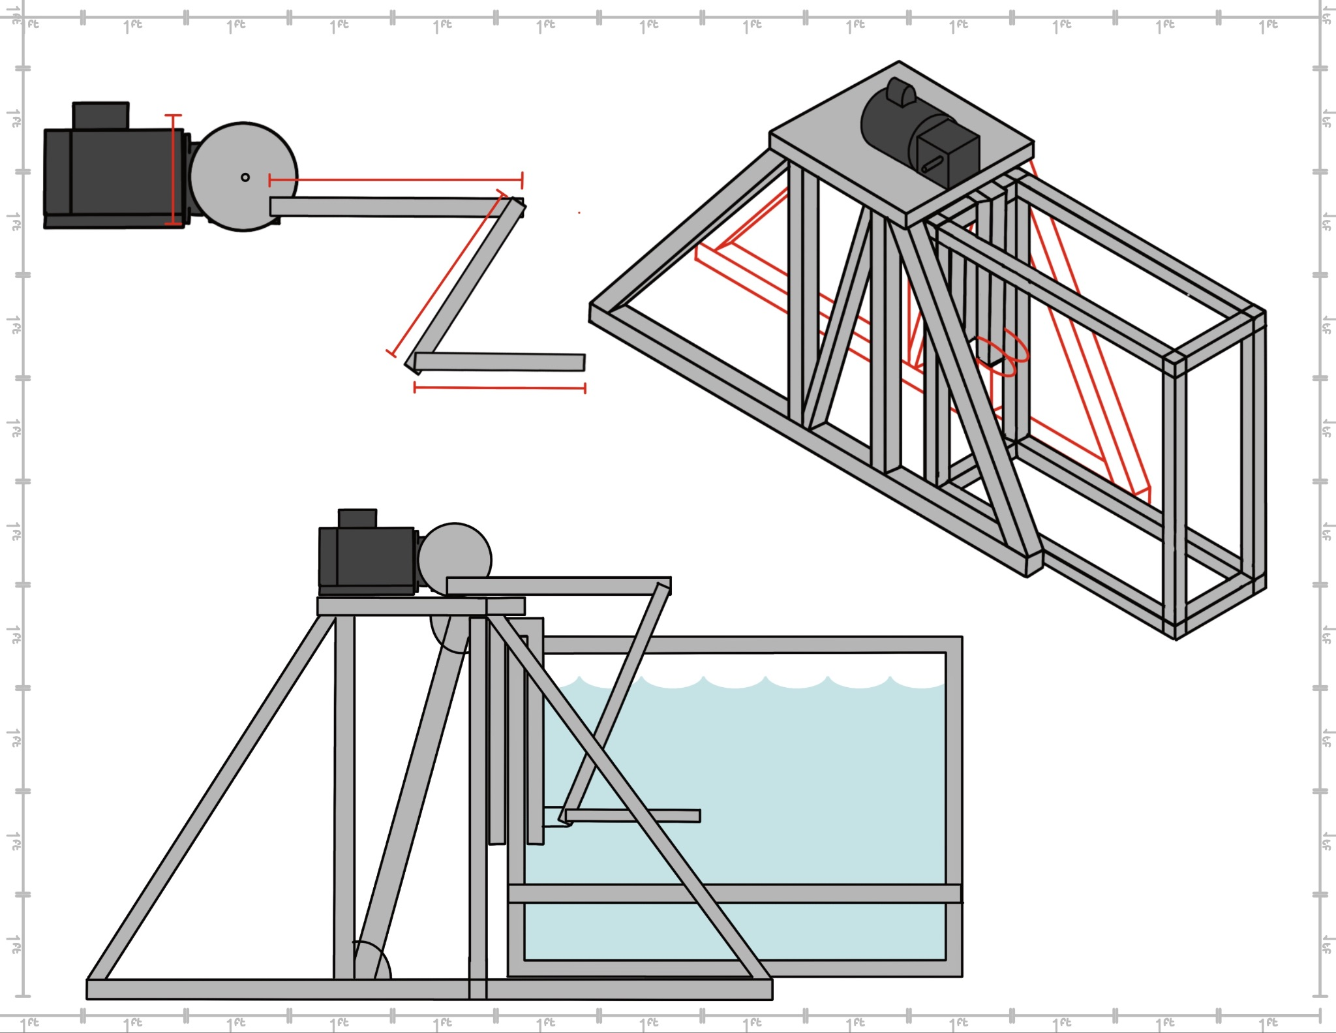
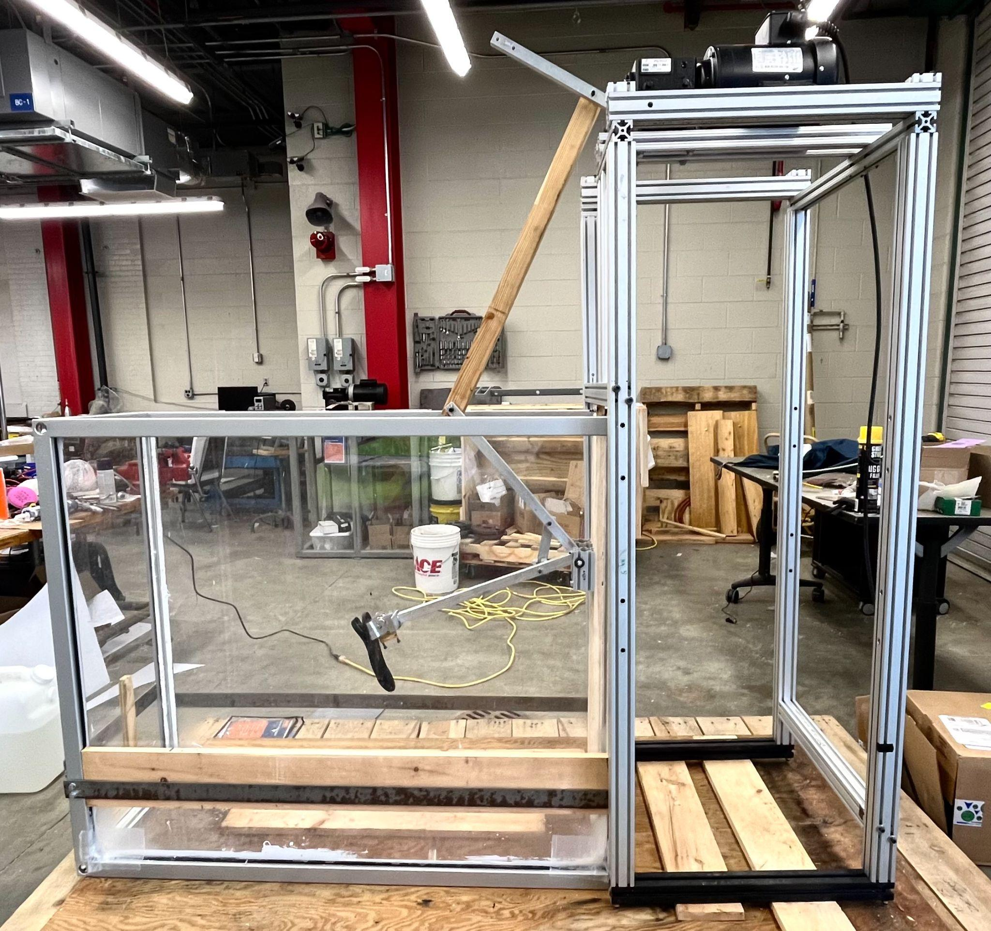
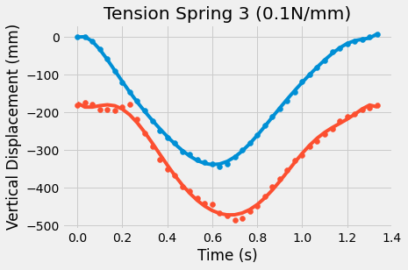
v
ME Team 68
Design of an Articulating Ankle for Enhanced Performance
Rachael Crow, Eric Brodeur, Kevin Cayo
MECHANICAL ENGINEERING
Sponsor: University of Hartford of Rehabilitation Sciences
Advisor: Dr. Jason Lee
Introduction/Motivation
Design 1: Tension Spring & Elastic Band
Objective: Design and develop a functioning articulating prosthetic ankle that can be utilized both on land and in subsurface environments for rehabilitation purposes
Scope: Research, design, fabricate, and test an articulating ankle that allows for effective and comfortable use both on land and for SCUBA Diving without adjustment to ankle position when switching environments
Parties of Interest:
Transtibial amputees
Ex Military & Veterans
Metrics:
Ankle range of motion
Recovery & Down stroke
Design Components:
Spring Constant Range: .1 - 1.5 N/mm
0.1 N/mm, 0.5 N/mm & 1.3 N/mm
Elastic Band Length: 50.8 mm
1, 5, 10
Pin: 10.5 mm diameter
Initial Concerns:
Longevity
Solution - Decrease pin diameter
Attractions:
Previous research has been conducted
Variation of design has been used
Allows for variation in type of component used
Spring or band
Critical Design Features:
Obtaining “ideal” ankle range of motion
65 degrees from the vertical
Limit Energy Exertion
Weather and water resistant
Design/Methodology
Initial Drawing
VS.
Goal: Create a device that allows for a balanced stroke while not locked in a fixed position
Prosthetic ankle produces similar stroke as able ankle - focus on recovery & down stroke
Inspirational Research
Rampro “Swimankle”
Nakashima Design
Human Anatomy
Rampro “Swimankle”
Test Rig Setup
Final Design - Tension Spring
Motor Set Up:
1800 rpm motor
Gear box of 40:1 ratio
Allowed for 45 kicks per minute
Motor stand to fit over the tank
80/20 stand
Arm configuration
2 aluminum pieces - 508 mm
1 wooden piece - 1219.2 mm
1 aluminum piece - 482.6 mm
Key cut out for motor
attachment
Hole location for wooden
arm connection
Tank Construction:
80/20 frame was used for frame
Plexi glass was used for the sides and bottom of tank
Water leakage prevention
Gasket & Caulk
Flex tape & Spray
Wooden supports
Reduce bowing of plexiglass due to pressure of water
Initial CAD Model
Final Design - Rubber Band
Results & Analysis Design 1
Ankle Joint
End of Prosthetic Foot
Strongest recovery stroke
Narrowest peak
Weakest downstroke
Lacks full ankle extension
Good downstroke
Near full extension of foot
Good recovery stroke
Narrow peak
Most balanced design of three tension springs
Initial Drawing
CAD Model
Motor & Gearbox
Weakest recovery
Thickest peak
Strong downstroke
Full ankle extension
Drawing with Motor Set Up
Final Design
Notes:
Flow is important: why is the project here, methodology (why we decided on our designs), rig, designs, comparison
Problems and how we overcame them!!!
dorsi to plantar, downstroke, plantar to dorsi, upstroke
Break down:
Introduction/motivation - Rachael
Methodology
Goals & prior research w Nakashima & rampro - Rachael
human anatomy - Kevin
Design & analysis motivation - Eric and Kevin
Test Rig Setup - Kevin
Problems encountered - Rachael
Design 1 & 2 & Analysis - Eric
Design 3 - Kevin
Design comparison - Eric
Conclusions & Recommendations - Rachael
One oscillation is 1.33 seconds because 45 oscillations per minute.
one oscillation is 40 frames at 30 fps

Slide 2
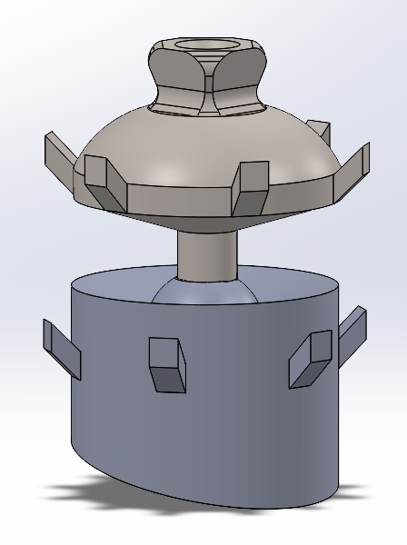
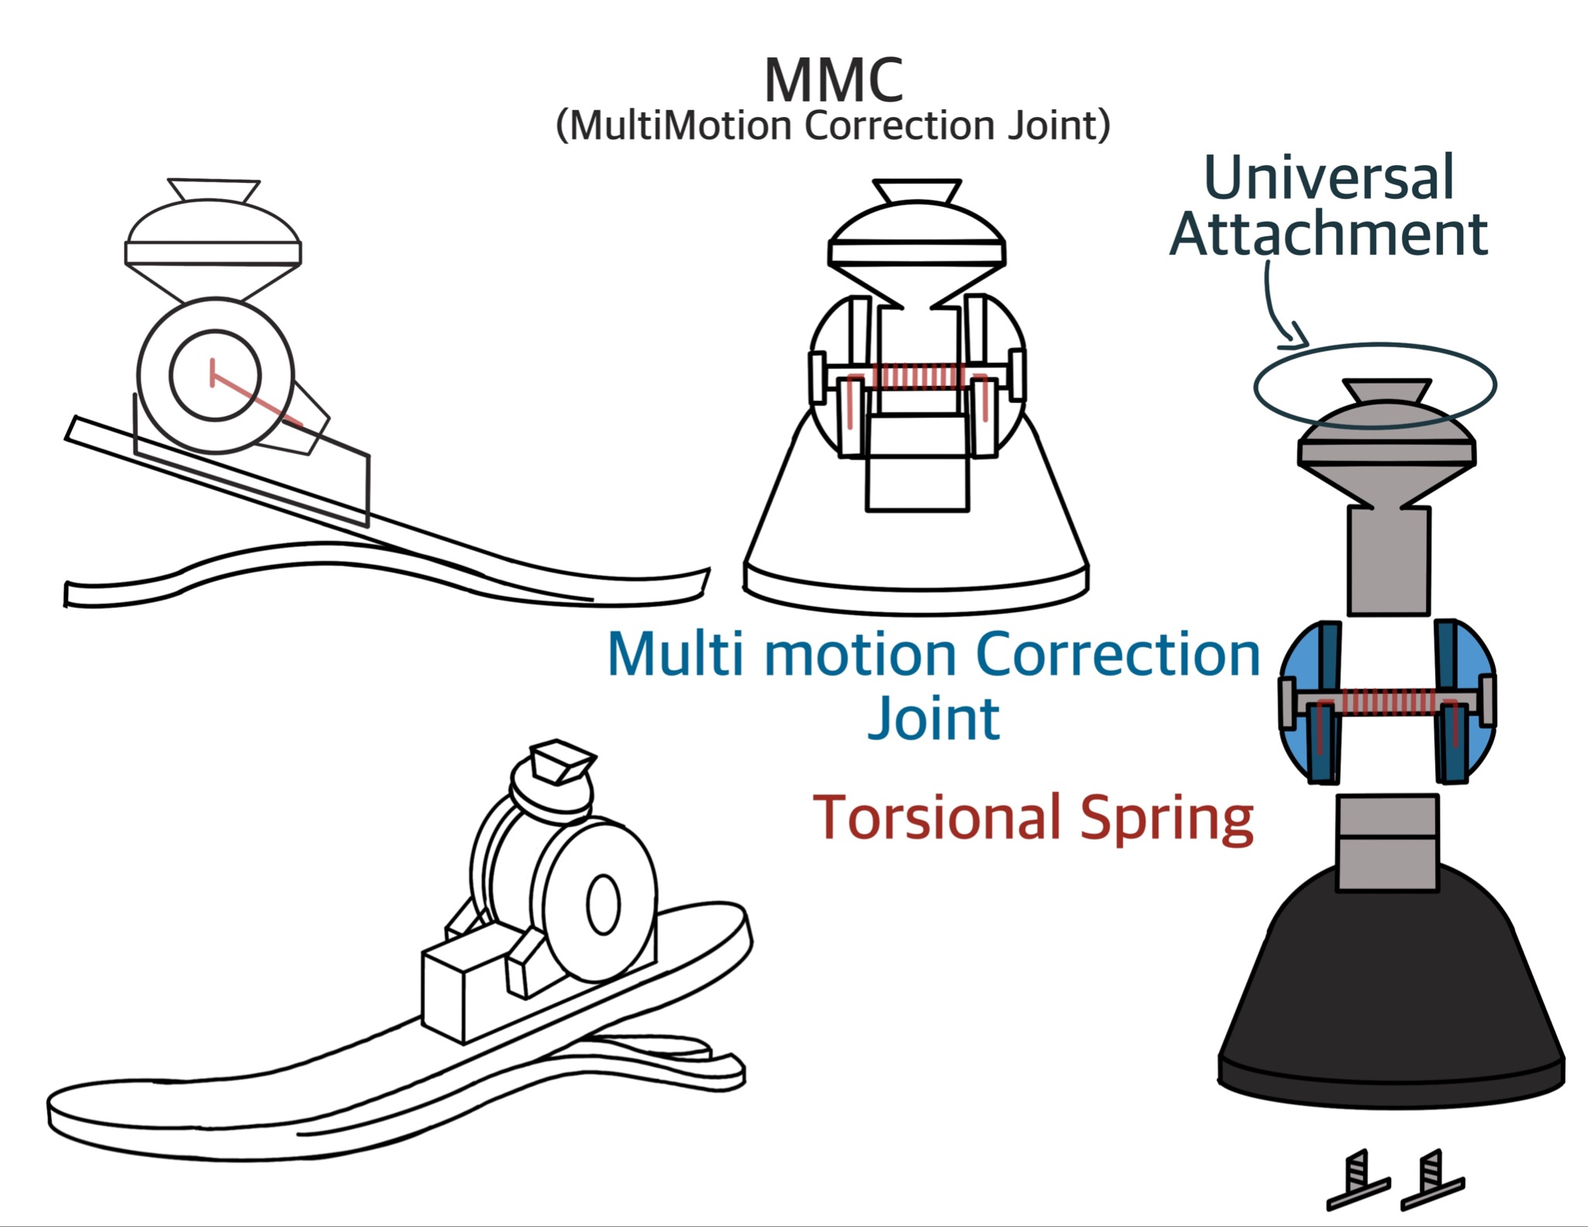
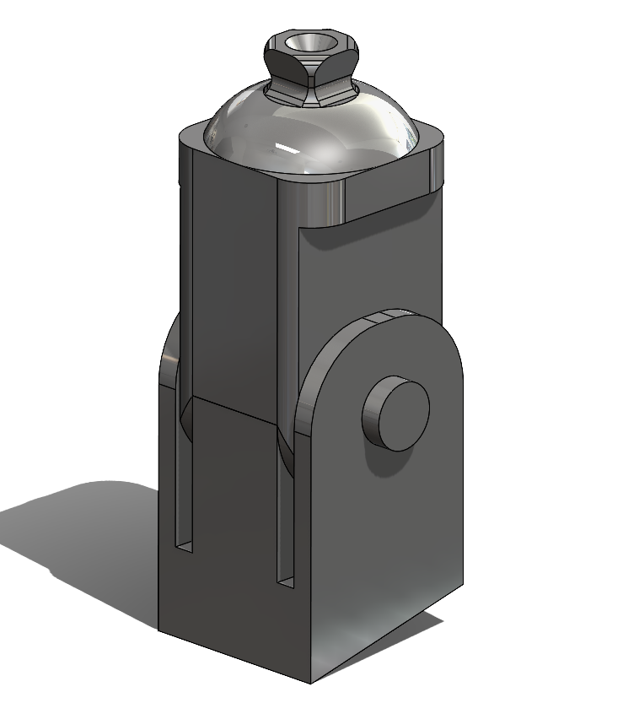
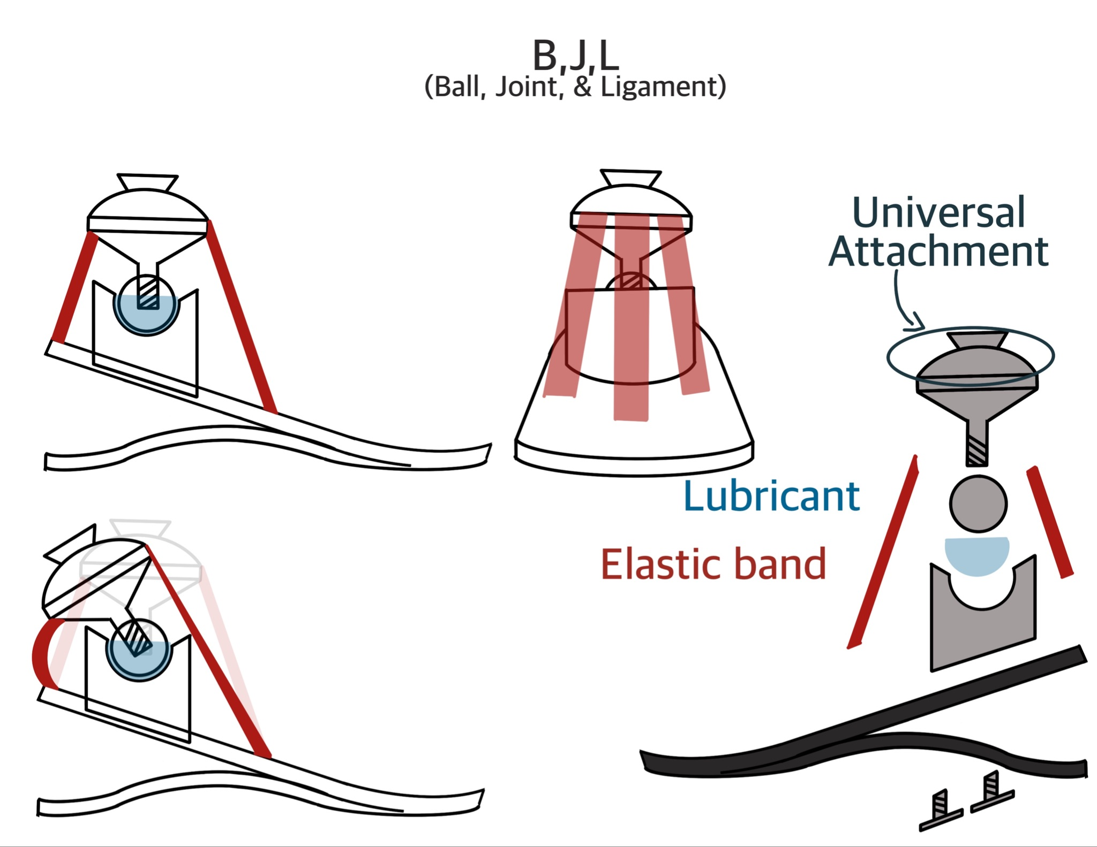
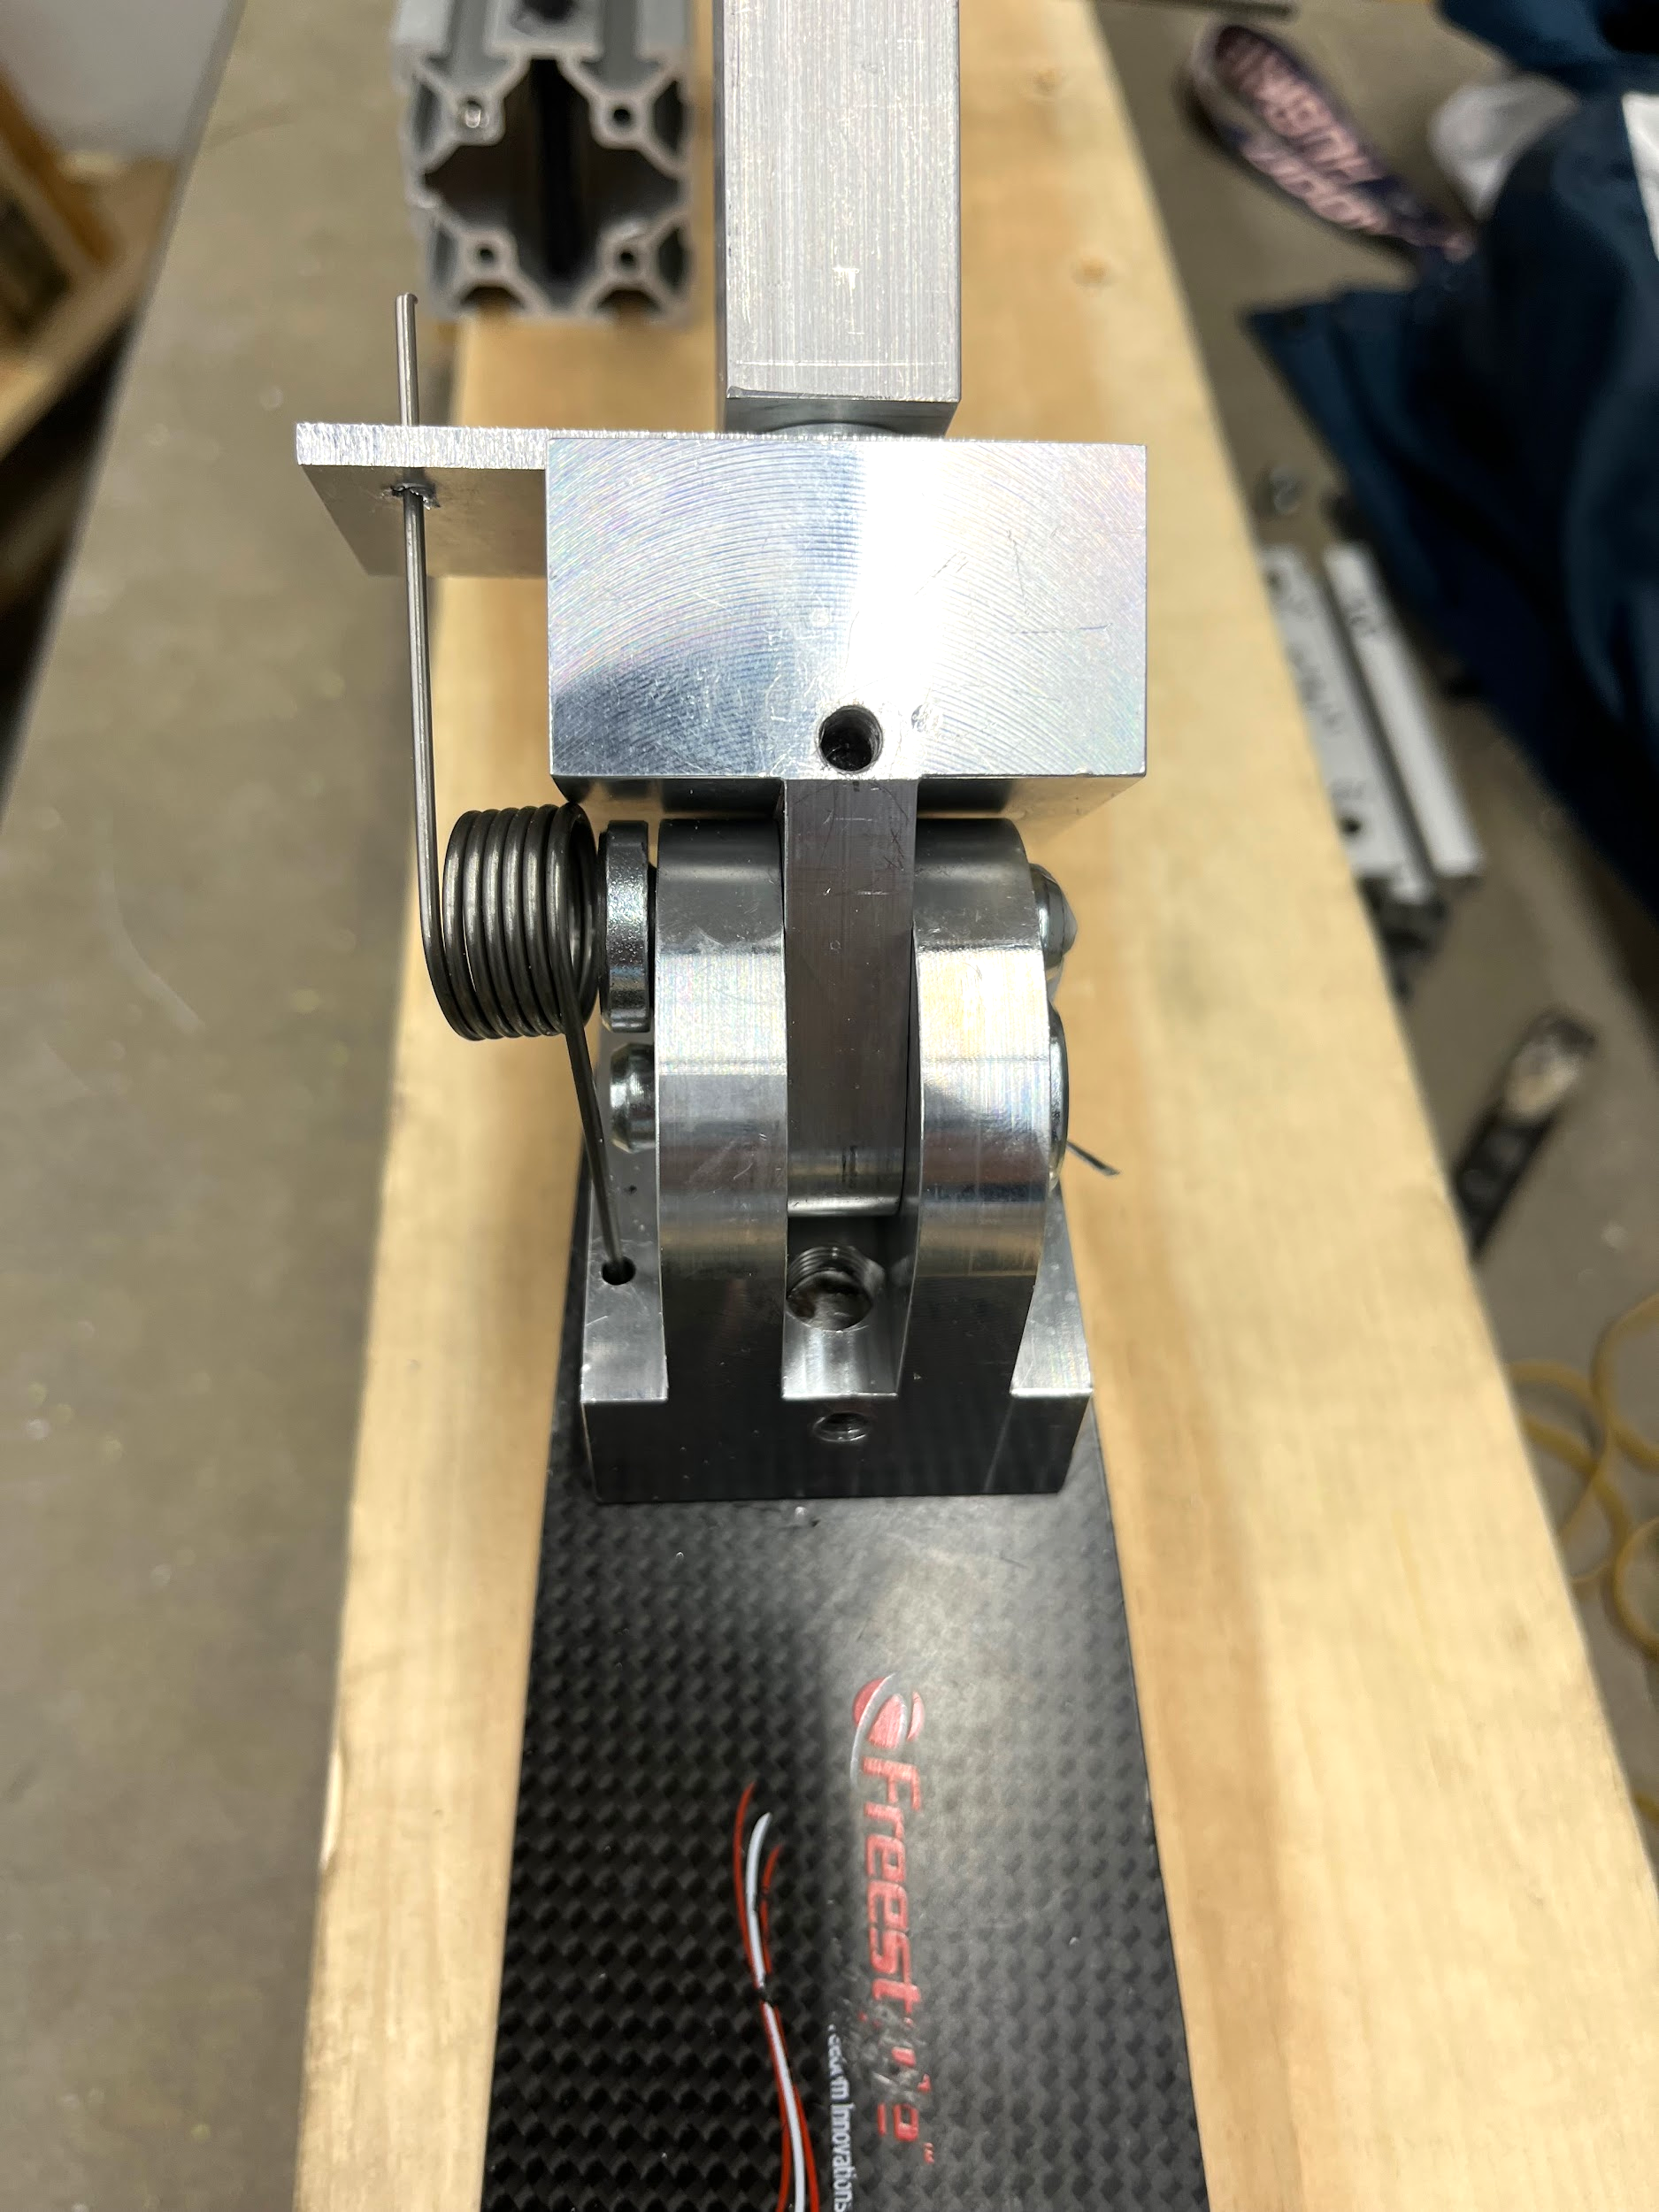
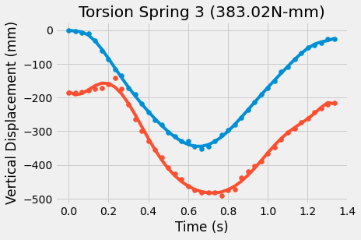
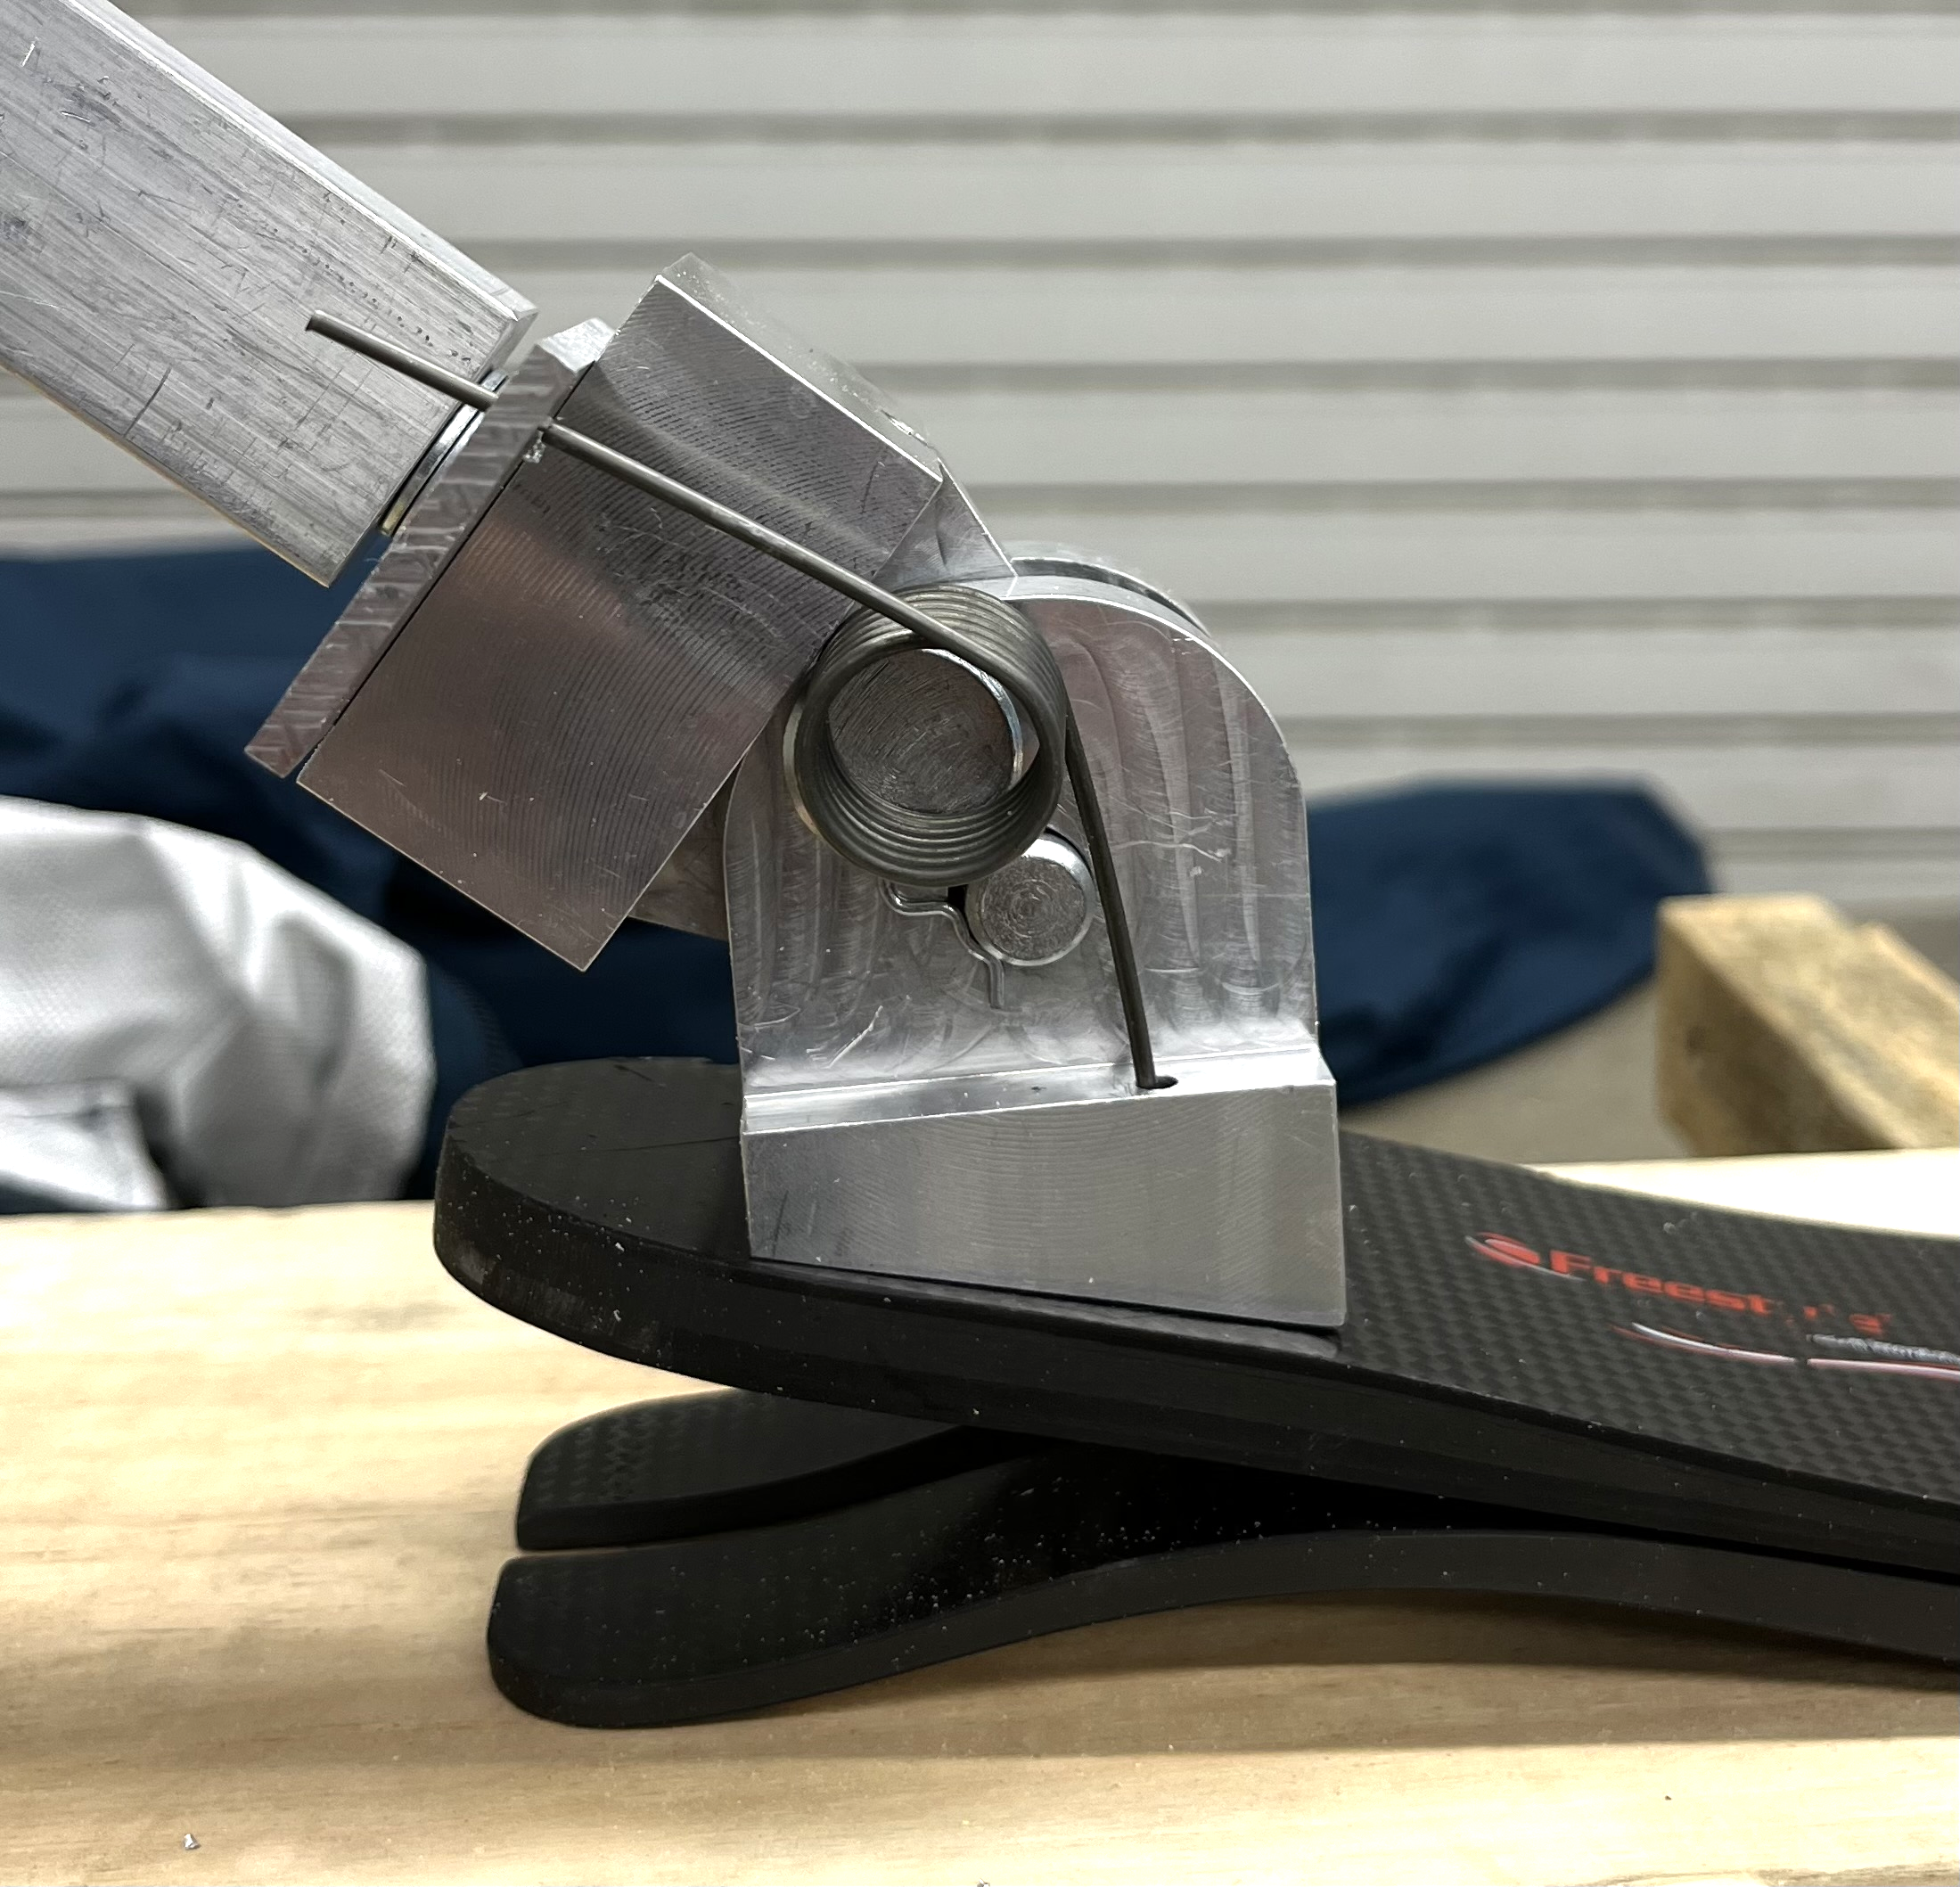
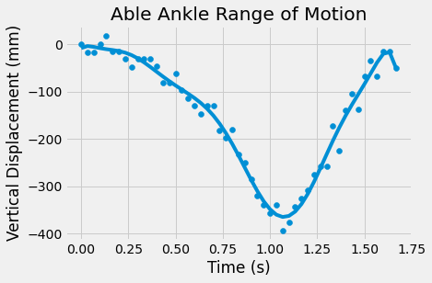
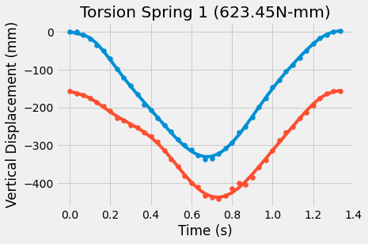
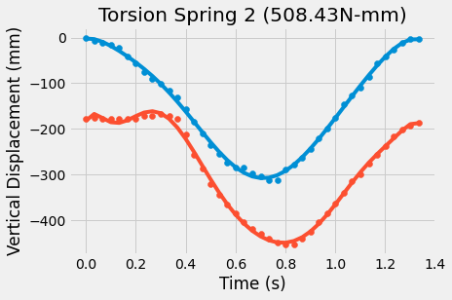
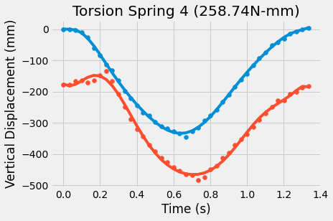
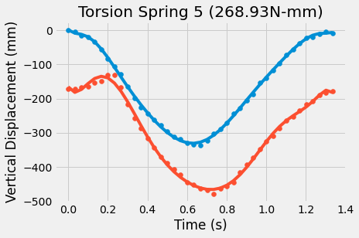
v
ME Team 68
Design of an Articulating Ankle for Enhanced Performance
Rachael Crow, Eric Brodeur, Kevin Cayo
MECHANICAL ENGINEERING
Sponsor: University of Hartford of Rehabilitation Sciences
Advisor: Dr. Jason Lee
Design 2: Torsional Spring
Design 3: Ball & Joint
Attractions:
Most sleek & compact design
Generates a lot of torque to help with recovery stroke
Design Components:
Lubricant: Oil or putty based
Elastic Band: 50.8 mm
Initial Concerns:
Lubrication Dissipation
Solution - Use of putty lubricant
Design Components:
Max Torque Range: 250 - 650 N*mm
258.74, 268.93, 383.02, 508.43, 623.45
Pin: 10.5 mm diameter
Initial Concerns:
Overextension
Solution - Add pin to limit range of motion
Attractions:
Most human like
Larger range of motion
Initial Drawing
Initial Drawing
Initial CAD Model
Design Comparison & Final Design
Initial CAD Model
Tension spring iteration 2 and torsion spring iteration 3 had the best balance of their respective springs
Torsion design had a stronger downstroke with a fully extended ankle while tension design had a better recovery
Final Design
Able ankle has longer downstroke and shorter upstroke because of required energy and drag
Could not simulate because powerful motor generated constant oscillation & no flipper use in test rig testing
Results & Analysis Design 2
Strongest recovery
Narrowest peak
Weakest downstroke
Ankle not fully extended
Torsional spring design has a more similar downstroke while tension spring design has a more similar upstroke
Both have same recovery angle as able foot
Satisfactory recovery
Slightly thicker peak
Good downstroke
Almost full extension of ankle
Conclusions & Recommendations
Conclusions
Torsion spring 3 performed best with ankle range of motion
Tension spring 2 produced the most balanced stroke out of design 1 & torsional spring 3 produced the most balanced stroke out of design 2
Torsional spring 3 performed better in terms of downstroke
Tension spring 2 performed better in terms of recovery stroke
Flipper deflection was inconclusive
Require a larger tank with slower arm oscillation
Can create a design that doesn’t require position adjustments
Recommendations
Complete Human Testing
Focus on quantitative & qualitative metrics
Flipper Deflection & ankle range of motion
SWOLF, pace, heart rate, & comfortability
Pursue finding “ideal” spring constant for tension spring design
Fabricate and test Ball & Joint Design
Less powerful recovery
Thicker peak
Strong Downstroke
Full extension of ankle
Weaker recovery
Thicker peak
Stronger Downstroke
Full extension of ankle
Weakest recovery
Thickest peak
Strongest Downstroke
Full extension of ankle
Closest path to ankle range of motion
Acknowledgements
UConn: Jason Lee, Vito Moreno, Thomas Mealy
Sponsor: Duffy Felmlee & Stephen Charry
References
“Activankle & Swimankle, Prosthetic Ankle Joints for Swimming, Jet/Snow Skiing, Rowing.” Rampro, https://www.rampro.net/ .
“Journal of Biomechanical Science and Engineering.” Development of the Transfemoral Prosthesis for Swimming Focused on Ankle Joint Motion, vol. 8, no. 1, 2013, p. 93. Journal of Biomechanical Science and Engineering, https://www.jstage.jst.go.jp/article/jbse/8/1/8_79/_pdf.
Notes:
go through designs after test rig set up and then discuss analysis and comparison after it
IRB takes time - requirement of processing for human subject testing
Can have graphs in one area (each design has a graph comparing their own iterations, pick the best one to compare in overall comparison area) and explain in comparison area

